Slide 1
Chapter 3 Functions
By
Hyung Jae (Chris) Chang
Troy University

Slide 2

Function Basics
Function
a sequence of instructions that performs a specific task.
a block of code that can run when it is called.
can have input arguments which are made available by the user (or the entity calling the function).
can have output parameters which are the results of the function once it has completed the given tasks.
Built-In Functions in Python
Examples: math.sin, np.array, and etc.
We can check if it is a built-in function by using type() function.

Slide 3
Function Basics (cont.)
Defining Your Own Functions
Function header: “def function_name(parameter1, parameter2, …):”
Function body: indented block indicating the main body of the function.
Descriptive string: description of the function, that can be accessed by the help() function or the question mark. This is enclosed by the triple single or triple double quotes.
Function statements: step-by-step instructions the function will execute when calling the function.
Return statements: may contain some parameters to be returned after the function is called.

Slide 4
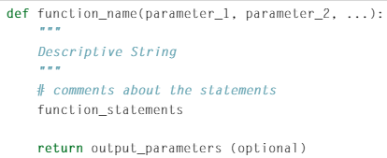
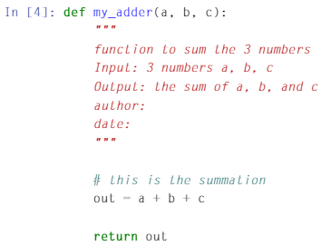
Example

Slide 5
Function Basics (cont.)
Functions must conform to a naming scheme similar to variables.
Only contain alphanumeric characters and underscores.
The first character must be a letter.
As a convention, function names should be lowercase, with words separated by underscores as necessary to improve readability.
It is a good practice to provide comments detailing the function to help yourself and other users use your functions correctly.

Slide 6
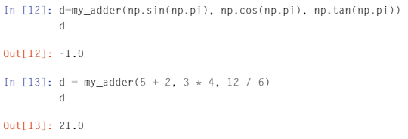
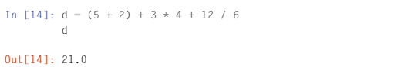
Function Basics (cont.)
Function can call another function as an argument.

Slide 7
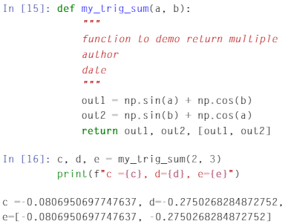
Function Basics (cont.)
Python functions can have multiple output parameters.
You can unpack the multiple output parameters with multiple variables separated by commas.
The variable e contains the list of
two elements.

Slide 8
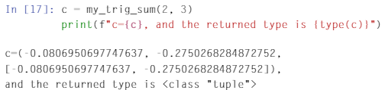
Function Basics (cont.)
If you assign multiple output results to one variable, you will get a tuple that includes all the output parameters.

Slide 9
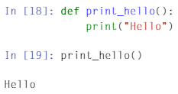
Function Basics (cont.)
We may have a function with no inputs and outputs.
Even there is no input argument, we still need to include the parentheses when we call the function.

Slide 10
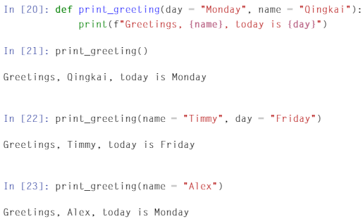
Function Basics (cont.)
For the input of the argument, we can include the default value as well; arguments are predetermined as a default setting when they are not provided during calling of the function.

Slide 11
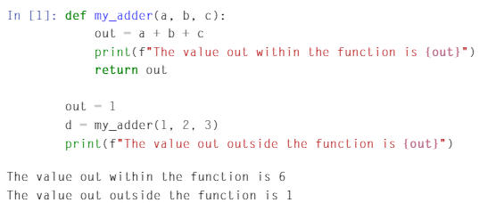
Local Variables and Global Variables
Variable: memory storage with the name of your choice.
A function also has its own memory block that is reserved for variables created within that function.
The name of the variable within the function can be the same as another variable defined outside the function.

Slide 12
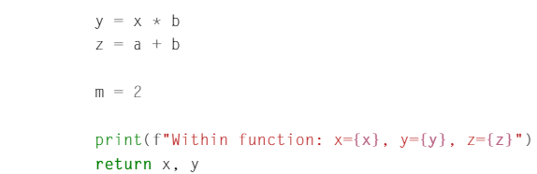
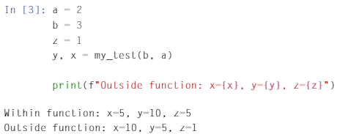
Local Variables and Global Variables (cont.)
Local variable: a variable defined in the function. This cannot affect variables outside of the function.

Slide 13
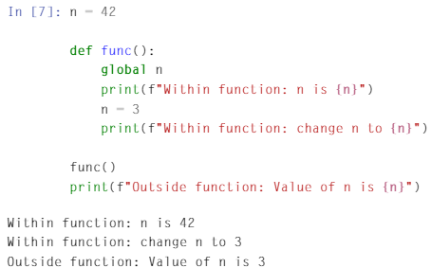
Local Variables and Global Variables (cont.)
Global variable: this can be used both outside and inside the function.

Slide 14
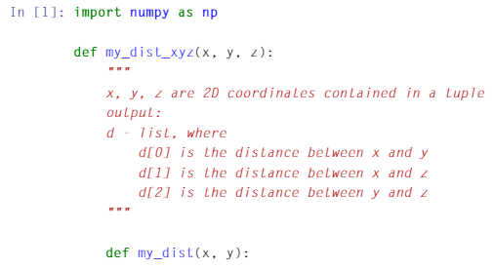
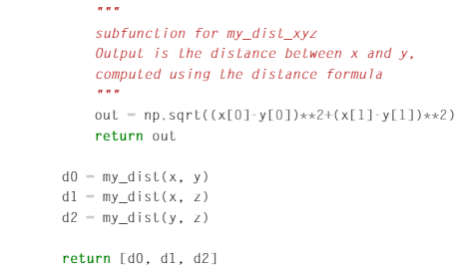
Nested Functions
We can create/include a function inside another function.
Only parent function can call the nested function.
It is permissible that both my_dist_xyz() and my_dist() functions have the variables x and y.

Slide 15
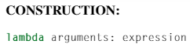
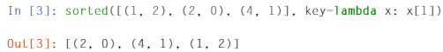
Lambda Functions
A function defined without a name
A lambda function is defined using the “lambda” keyword.
If a function contains one single statement, a lambda function is useful.
Returns a function object.

Slide 16
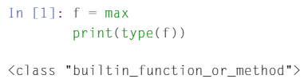
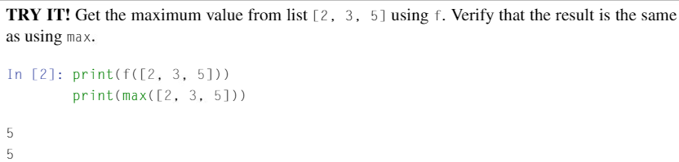
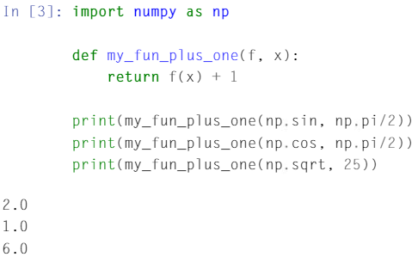
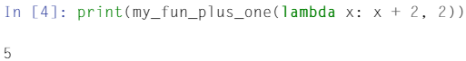
Functions as Arguments to Functions
We can pass a function and have it act as a variable to another function; the input to some functions may be other functions.

Slide 17
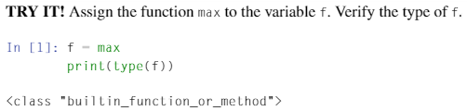
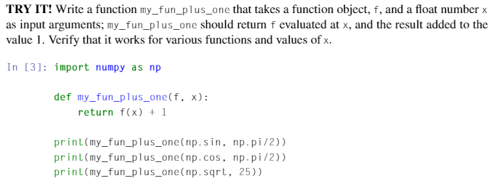
Functions as Arguments to Functions (cont.)
We can pass a function and have it act as a variable to another function; the input to some functions may be other functions.

